Slide 1
“The Man of Property”: Impression

Slide 2
Philip Bosinney was known to be a young man without a fortune…
“Very haughty , the wild Buccanear!”
“… Phil never knows what he`s got on”

Slide 3
“A tall woman, with a beautiful figure…”
“Her figure swayed, so balanced that the very air seemed to set it moving. There was warmth , but little colour, in her cheeks; her large, dark eyes were soft”

Slide 4
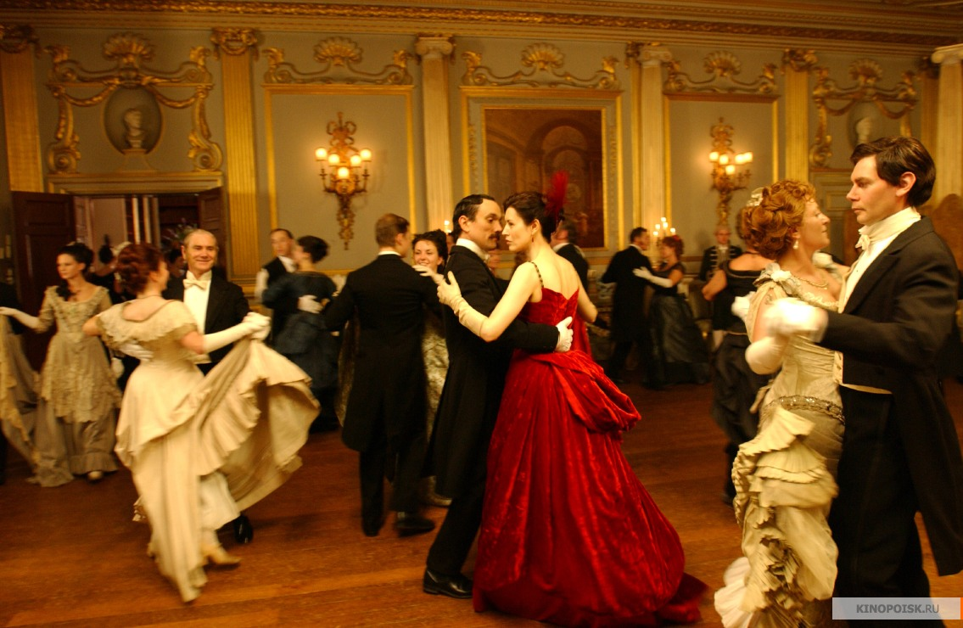
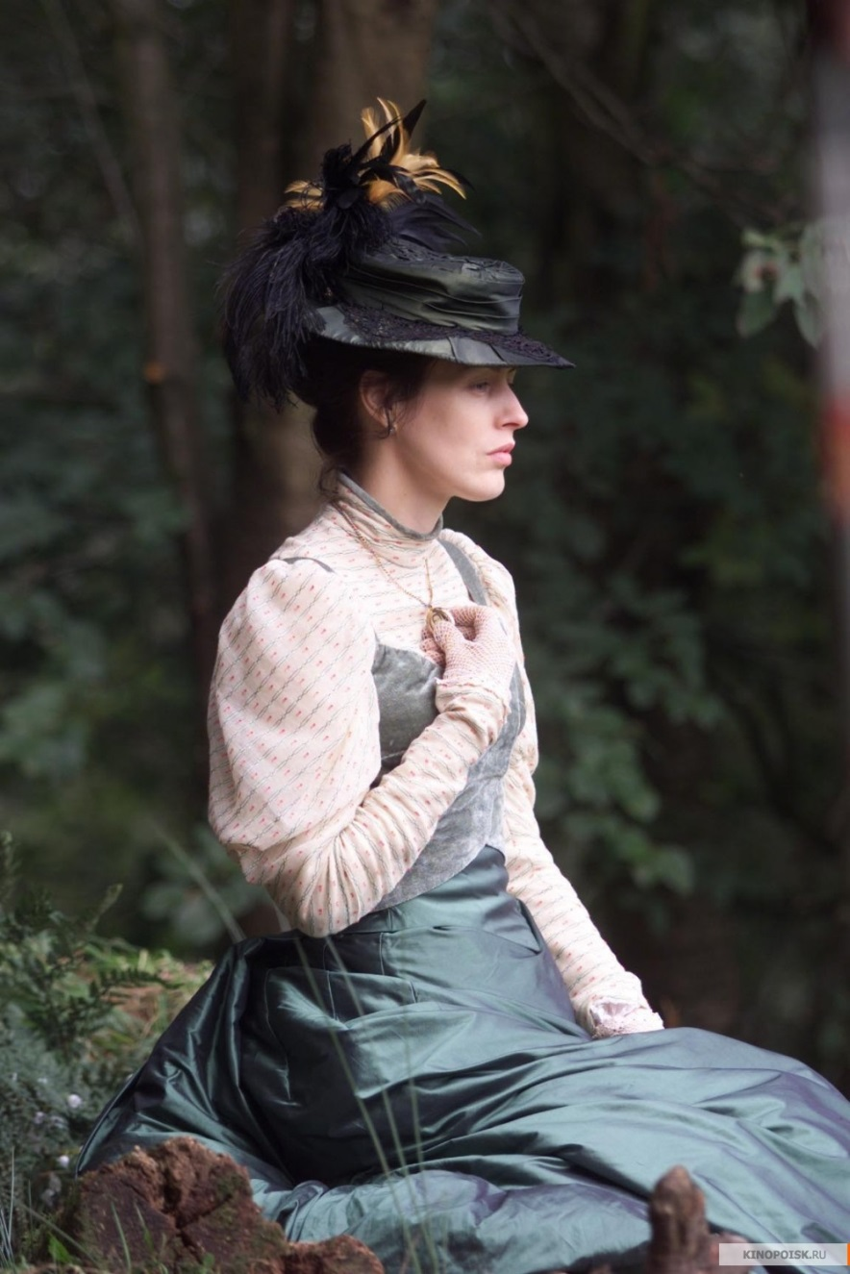
« The Forsyte Saga », 2002
Philip and Irene

Slide 5
“Bosinney was waiting for him at the door ; and on his rugged, good-looking face was a queer, yearning , yet happy smile…”
“June saw Irene look up at him through her screen of blossoms. … that look should say too much”

Slide 6
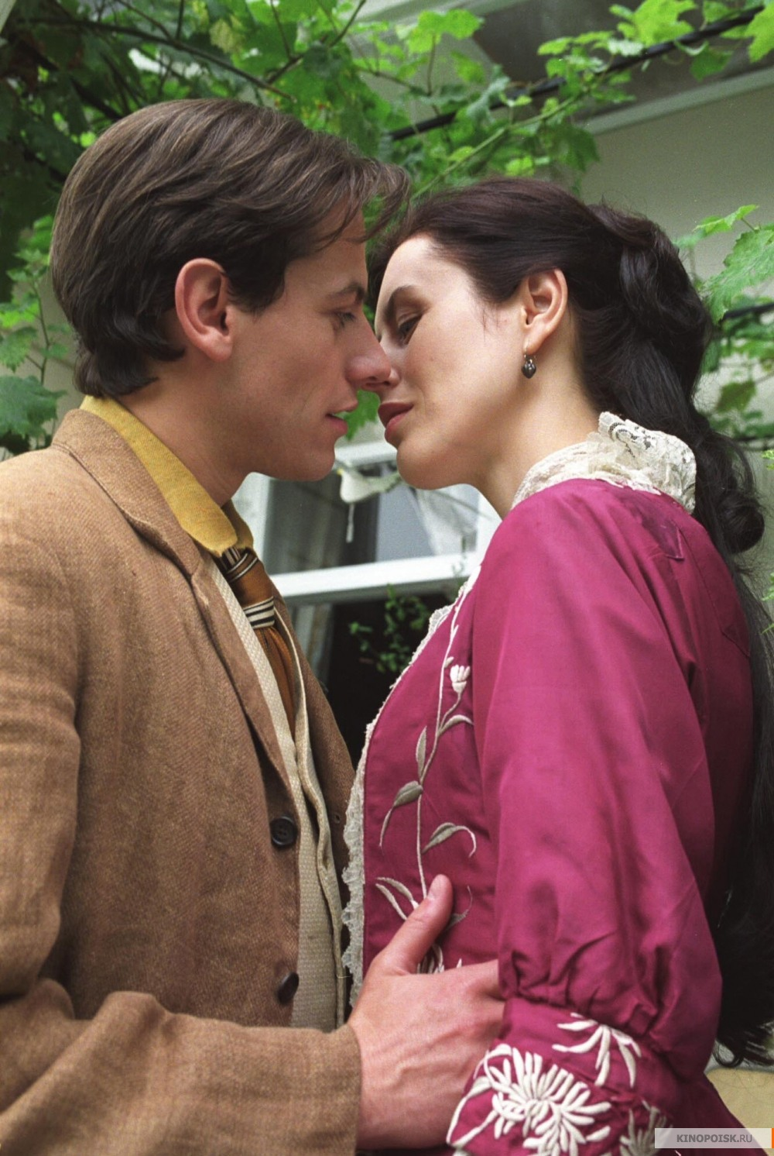
« The Forsyte Saga », 2002
Philip and Irene

Slide 7
The Long hours of waiting
The tortures of suspense
The meeting
Look in their eyes
The long clasp of their hands
The rapid murmur of their talk
This was the real thing!

Slide 8
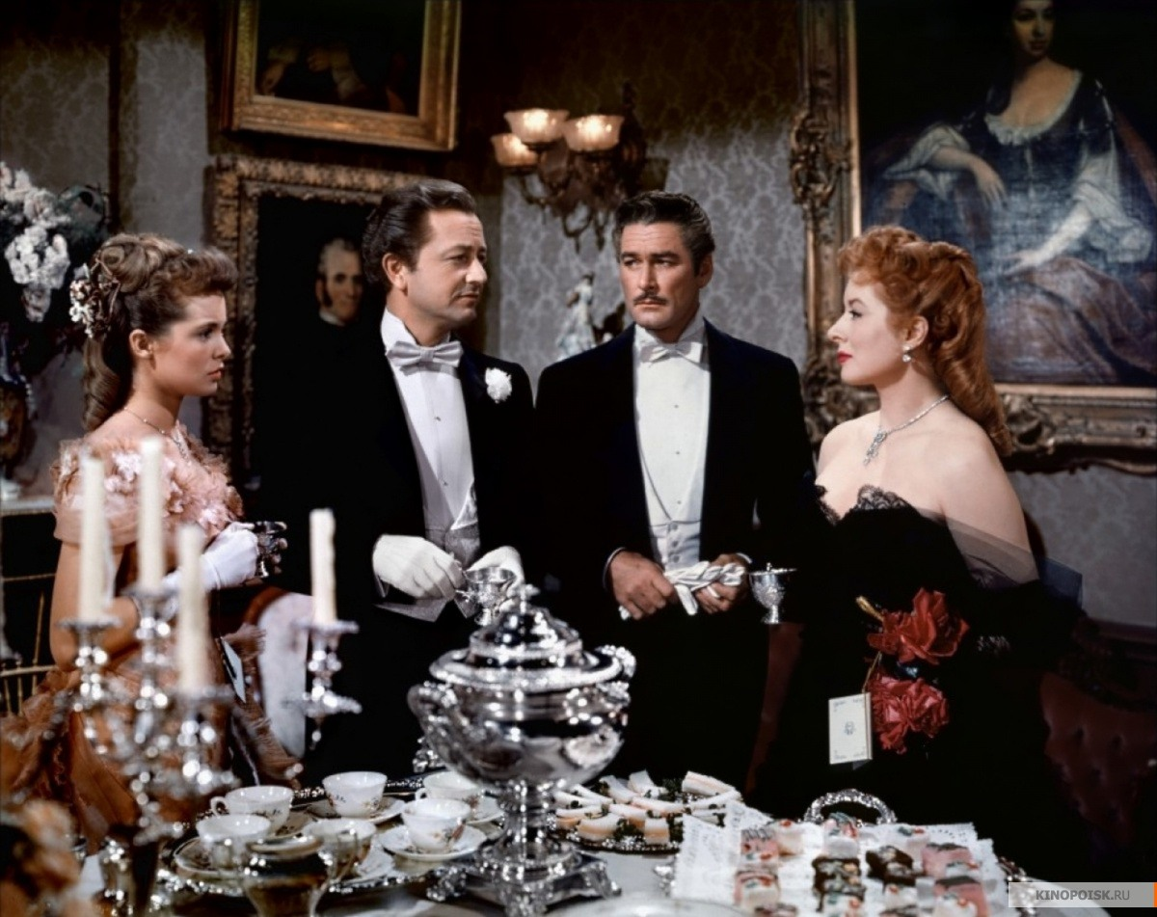
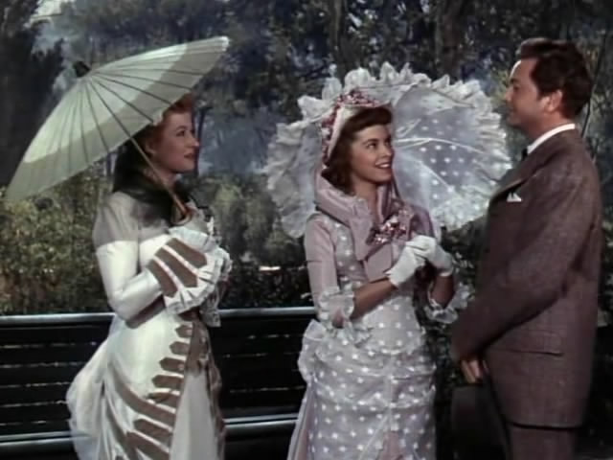
« That Forsyte Woman » 1949, Philip, Irene, June and Soames

Slide 9
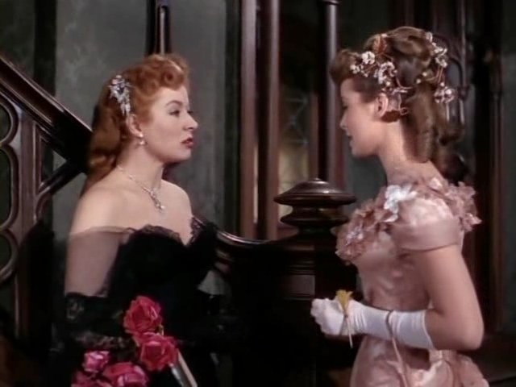
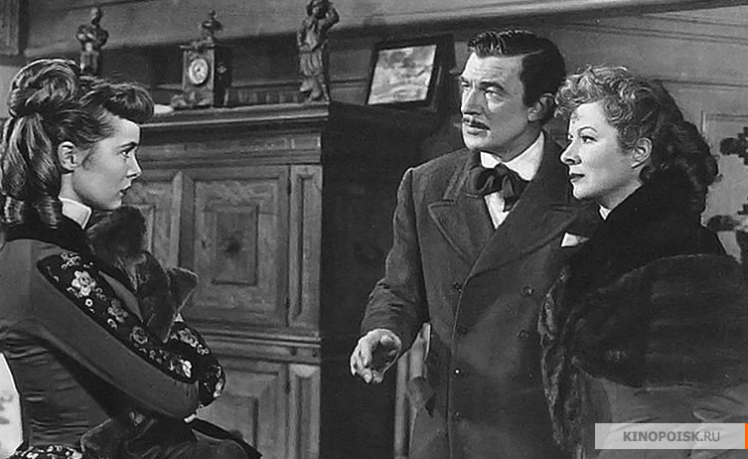
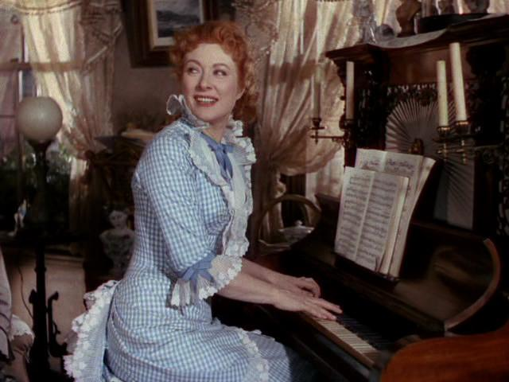
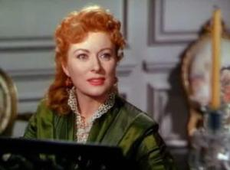
« That Forsyte Woman » 1949

Slide 10
“… Love is not hot-house flower , but a wild plant …
A wild plant that, when it blossoms by chance within the hedge of our gardens, we call a flower; and when it blossoms outside we call a weed; but, flower or weed, whose scent and colour are always wild!”

Slide 11
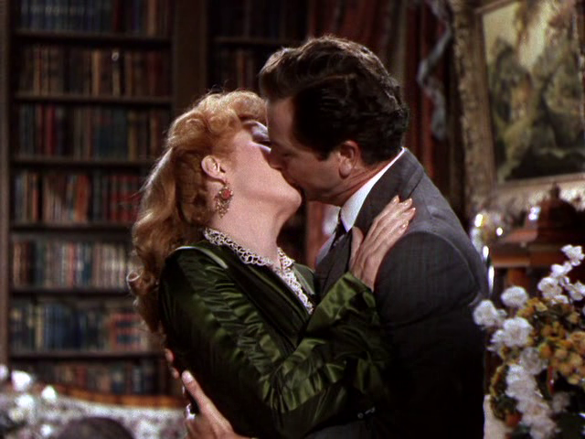

Slide 12
Ю. Титова,
2016

