Slide 1
Образ мистера Рочестера в романе Ш. Бронте "Джейн Эйр"
“You, Jane, I must have you for my own –
entirely my own”

Slide 2
Внешность
Не красавец, но привлекателен
I traced the general points of middle height and considerable breadth of chest. He had a dark face, with stern features and a heavy brow; (…) he was past youth, but had not reached middle-age; (…) Had he been a handsome, heroic-looking young gentleman.
(…) his broad and jetty eyebrows; his square forehead, made squarer by the horizontal sweep of his black hair. (…) his decisive nose, more remarkable for character than beauty; (…) his grim mouth, chin, and jaw; (…) it was a good figure in the athletic sense of the term—broad chested and thin flanked, though neither tall nor graceful.

Slide 3
Внешность
Надменный взгляд, внешность властного человека
I am sure most people would have thought him an ugly man; yet there was so much unconscious pride in his port; so much ease in his demeanour; such a look of complete indifference to his own external appearance; so haughty a reliance on the power of other qualities, (…) that, in looking at him, one inevitably shared the indifference, and, even in a blind, imperfect sense, put faith in the confidence.
(…) they (his strong features) were full of an interest, an influence that quite mastered me,—that took my feelings from my own power and fettered them in his.

Slide 4
Образование
Получил хорошее образование, много путешествовал
“Ah!” cried she, in French, “you speak my language as well as Mr. Rochester does”
“he has a gentleman’s tastes and habits”
“he has travelled a great deal, and seen a great deal of the world”
She and Mr. Rochester sang a duet.

Slide 5
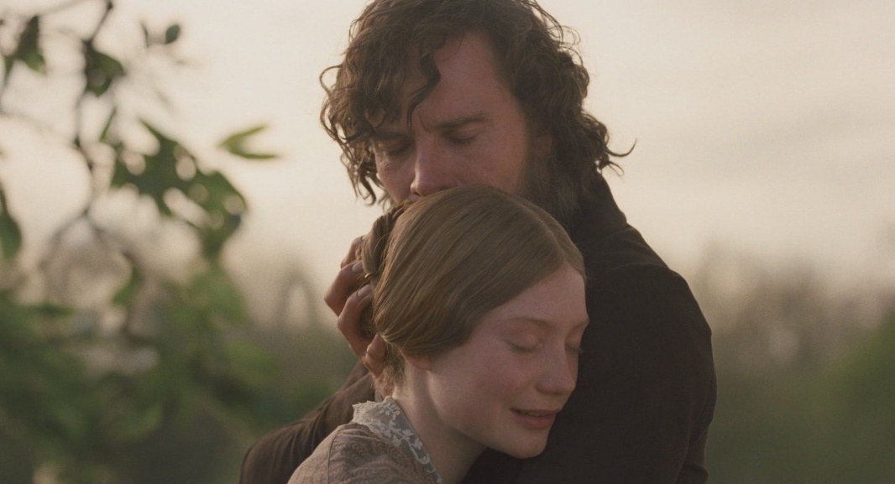
Положение в обществе
“Oh, yes; the family have always been respected here.”
He is a proud man: all the Rochesters were proud: and his father, at least, liked money. He, too, has always been called careful.
Mr. Rochester is so talented and so lively in society, that I believe he is a general favourite: the ladies are very fond of him; (…) his acquirements and abilities, perhaps his wealth and good blood, make amends for any little fault of look.
Произошел из уважаемой семьи, популярен в обществе

Slide 6
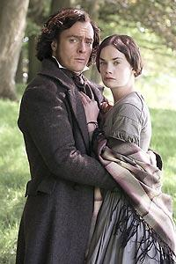
Речь
Командный тон, прямолинейность
Глаголы, характеризующие речь: said the deep and rather sarcastic voice of Mr. Rochester, resumed, demanded, urged, correcting himself, inquired, cried, directed, propounded his query, exclaimed, interposed, etc.
Mr. Rochester had such a direct way of giving orders, it seemed a matter of course to obey him promptly.
“What the deuce is to do now?” (…) he was swearing.

Slide 7
Отношение к людям
Высокомерный, надменный
Mr. Rochester had again summoned the ladies round him, and was selecting certain of their number to be of his party. (любимец женщин)
I might pass hours in his presence, and he would never once turn his eyes in my direction. (безразличный, холодный)
“Excuse my tone of command; I am used to say, ‘Do this,’ and it is done: I cannot alter my customary habits for one new inmate.” (властный)
“I said I did not like the society of children and old women.” (прямолинейный)
Mr. Rochester is an amateur of the decided and eccentric. (избирательный)

Slide 8
Отношения с Джейн
Любящий и преданный
Mr. Rochester had sometimes read my unspoken thoughts with an acumen to me incomprehensible. (чуткий, понимающий)
Rochester: “when you are near me, as now: it is as if I had a string somewhere under my left ribs”; “because my equal is here, and my likeness”; “my very soul demands you”. (страстный, романтичный)
He broke off acquaintance with all the gentry, and shut himself up like a hermit at the Hall. (Без Джейн ему жизнь не мила, он отгораживается от окружающего мира и уходит в себя.)

Slide 9
Выводы
Итак, образ мистера Рочестера сохраняет привлекательность для читательниц многих поколений.
Его образ загадочен; это влечет Джейн и читателя.
Эмоциональный, властный, он покоряет нас своей необычностью.
Он не говорит попусту, предпочитает словам действия. Он не говорит о себе, мы никогда не знаем, что у него в мыслях.
Он интересен всем, начиная с внешности и заканчивая поступками. Его непостижимая и страстная натура – многогранна, и каждый читатель найдет в этом образе то, что ему по душе.

Slide 10
Работу выполнили:
Баринова В.В. 402а
Разумкова М.П. 403а
2013 г.

